Slide 1
How to Use Bison and Flex included in Cygwin on Windows
This presentation explains how to use bison and flex included in Cygwin on Windows platform, i.e., how to use them to generate syntax parser and lexical analyzer respectively. If you have not installed them yet, please watch the videos linked below:
How to Install Bison and Flex included in Cygwin on Windows platform
https://youtu.be/8hTqKad7aH8
How to use bison and flex to generate syntax parser and lexical analyzer
https://youtu.be/E6vuitIWpfM

Slide 2
001 Bison and Flex
In this session, we will learn
What We Should Do
What Bison Does
What Flex Does
How to Compile
Function Call Sequence
Make Settings in Visual Studio IDE

Slide 3
1. What We Should Do
We create 3 files and 2 functions
Lexer.l - the Flex grammar file
Parser.y - the Bison grammar file
Source.cpp, which contains
    int main()
    void yyerror(const char*)

Slide 4
2. What Bison Does
Bison generates two files using parser.y or called Bison grammar file
parser.cpp
  contains the famous int yyparse() or is called “syntax parser”
parser.h
  contains tokens that are used in “lexical analyzer”
So, Bison generates parser.cpp and parser.h using parser.y that we create by ourselves. parser.cpp contains int yyarse() generated by Bison and is called syntax parser or simply the parser. The parser.h, generated by Bison, is used in the “lexical analyzer” generated by Flex.

Slide 5
3. What Flex Does
Flex generates one file using lexer.y or Flex grammar (or rules) file
lexer.cpp
  which contains int yylex() or called “lexical analyzer”
So, Flex generates one file lexer.cpp using lexer.l in which we define lexical rules (in regular expression). lexer.cpp includes one very important function int yylex() generated by Flex and is called “lexical analyzer”

Slide 6
Let’s Recap What We’ve Learned
We create 3 files
  lexer.l – which is called Flex grammar file
  parser.y – which is called Bison grammar file
  Source.cpp – which contains int main() and void yyerror(const char*)
Bison generates two files using parser.y
  parser.cpp which contains int yyparse() or is called “syntax analyzer”
  parser.h which contains tokens used by “lexical analyzer” or int yylex()
Flex generates one file using lexer.l
  lexer.cpp which contains int yylex() or “lexical analyzer”
Because the lexical analyzer or int yylex() in lexer.cpp uses tokens generated by Bison, contained in parser.h, the lexer.cpp should be regenerated each time parser.y is modified.
That is, parser.y should always be compiled PRIOR TO lexer.l, which contains C/C++ directive,
#include “parser.h”

Slide 7
4. How to Compile
We should always compile Bison grammar file or parser.y FIRST
bison –o parser.cpp parser.y
  Compile parser.y and generate parser.cpp and parser.h
  ( %defines “parser.h” in parser.y directs Bison to generate parser.h)
flex –o lexer.cpp lexer.l
  Compile lexer.l and generate lexer.cpp
Finally to build source.exe
  using Microsoft compiler
  prompt>cl /EHsc source.cpp lexer.cpp parser.cpp /Fe: source.exe
  using GNU compiler
  prompt>g++ source.cpp lexer.cpp parser.cpp –o source.exe

Slide 8
5. Function Call Sequence
Source.cpp
int main()
{
yyparse();
}
void yyerror(const char*)
{
…
}
parser.cpp
int yyparse()
{
while( (token = yylex()) != 0 )
{
switch(token)
{
case rule1:
…
case rule2:
…
case rule3:
if error then yyerror(msg)
}
}
return xxx;
}
lexer.cpp
int yylex()
{
case 1:
return token1
case 2:
return token2
case 3:
return token3
…
}

Slide 9
6. Settings in Visual Studio IDE
Keep it in mind that we have to compile parser.y FIRST with Bison
For the command-line command;
prompt> bison -o parser.cpp parser.y
in Visual Studio, %(Identity) corresponds to parser.y
%(Filename) corresponds to parser, which means
%(Filename).cpp resolves to parser.cpp, So the command-line
prompt> bison -o parser.cpp parser.y
is equivalent to
bison -o %(Filename).cpp %(Identity)
in Visual Studio IDE.

Slide 10
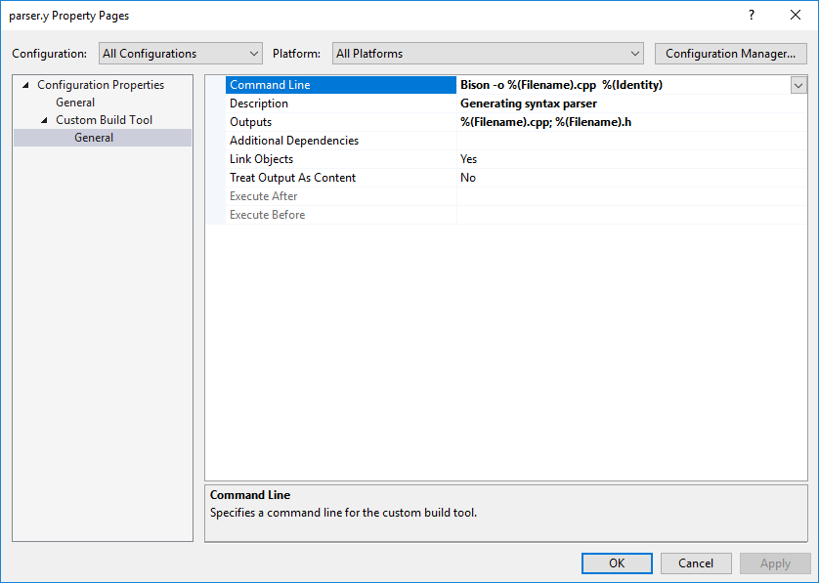
Bison Compile Settings
Command Line:
Bison –o %(Filename).cpp %(Identity)
Outputs:
%(Filename).cpp ; %(Filename).h

Slide 11
Flex Compile Settings
Command-line command
prompt> flex -o lexer.cpp lexer.l
equivalent to
flex -o %(Filename).cpp %(Identity)
In Visual Studio, the generated lexer.cpp is dependent on parser.h which is to be generated by Bison. So Additional dependencies setting (see next slide) is important. This setting directs Visual Studio to recompile lexer.l whenever parser.y is modified.

Slide 12
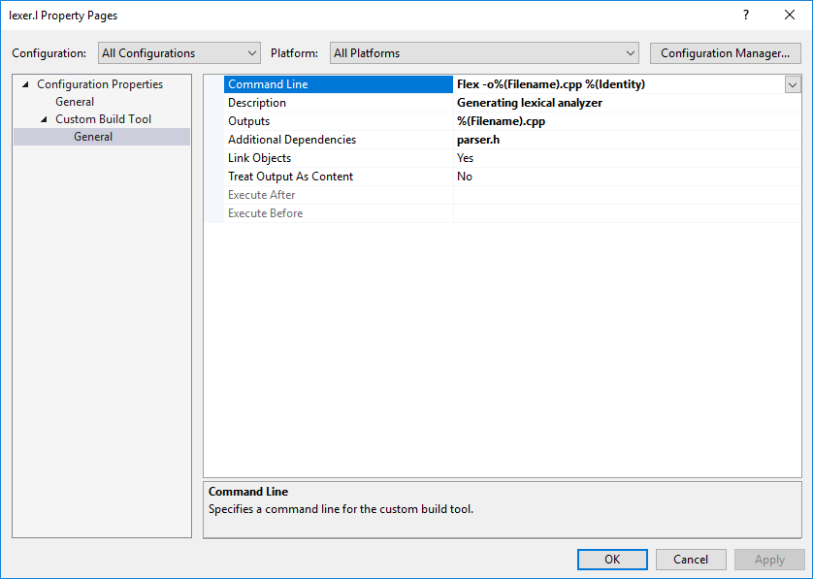
Flex Compile Settings
Command Line:
Flex -o %(Filename).cpp %(Identity)
Outputs: %(Filename).cpp
Additional Dependencies: parser.h

Slide 13
Than You for Watching!
By Thomas Kim
Feb. 17, 2017
http://www.TalkPlayFun.com
http://www.TranslatosFrom.Asia
YouTube: https://youtu.be/E6vuitIWpfM

